Slide 1
Diagnosis
Hyperaldosteronism: Normal
Serum Potassium < 3.5 mEq/L 3.5 – 5
Urinary Potassium > 30 mEq/24 hr

Slide 2
Hypothalamus
HyPER Treatment
CRF
Ectopic ACTH Syndrome: Surgery
Pituitary Dependent Cushings Disease: Surgery
or Aminoglutethimide
or ketoconazole or Cyproheptadine
Anterior Pituitary
ACTH
- Adrenal Carcinoma: Surgery
If inoperable then Mitotane 10 grams daily
Adrenal Cortex
Aldosterone
Androgens
Glucocorticoids
- Bilateral Adrenal Hyperplasia Hyperaldosteronism: Spironolactone
- Aldosterone dependent adenoma: Surgery
- Secondary Aldosteronism: Surgery + Spironolactone
Notes:
Secondary hyperaldosteronism (also hyperreninism, or hyperreninemic hyperaldosteronism) is due to overactivity of the renin-angiotensin system.

Slide 3
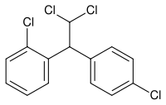
Drugs that treat HyPERfunction of Adrenal Gland
Drug | Treat | MOA | Comments
Mitotane | inoperable adrenocortical carcinoma | Inhibits adrenocortical function by causing cellular destruction/atrophy
Aminoglutethimide (Cytadren) | Cushings | Inhibit cortisol synthesis | cause sedation; nausea, ataxia glutethimide- older agent use as a sedative, found by accident to have effects on cortisol synthesis
Ketoconazole (Nizoral) | Antifungal & Cushings | Inhibit cortisol synthesis
Cyproheptadine (Periactin) | Cushings | Blocks 5-HT and decreases ACTH | 4 mg BID
Notes:
Metyrapone (Metopirone ®) is the pharmacologic agent of choice.
Metyrapone inhibits 11-β-hydroxylase activity resulting in cortisol synthesis inhibition.

Slide 4
HyPO Treatment
Hypothalamus
Secondary hypo aldosterone
1. Prednisone 5 mg PO aAM
or
Hydrocortisone 20 mg PO qAM
+
2. Prednisone 2.5 mg PO qPM
or
Hydrocortisone 10 mg PO qPM
+
3. If low mineralocorticoid then Fludrocortisone
CRF
Anterior Pituitary
ACTH
Adrenal Cortex
Addison’s
Treat same as Secondary Hypo
Acute Adrenal Insufficiency
1. 100 mg IV hydrocortisone rapid infusion
2. 100 mg IV hydrocoritison q8h for 48hr
3. D5NS 0.5 L/hr
Aldosterone
Androgens
Glucocorticoids

Slide 5
-
Hypothalamus
Corticotropin-
releasing hormone
CRF
Anterior Pituitary
Adrenocorticotropic
hormone
ACTH
Adrenal Cortex
(on next slide)
Aldosterone
Androgens
Glucocorticoids
Hold Na
Pump out K
SEX!
Sugar &
inflammation

Slide 6
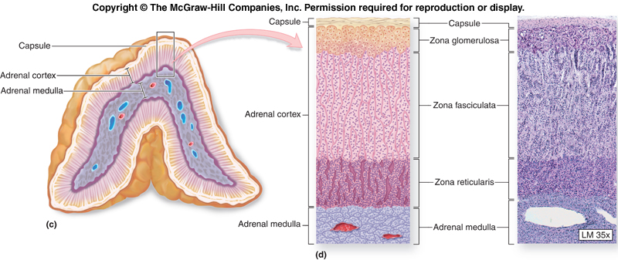
Adrenal Cortex
+
G
Adrenal Cortex
()
NE
Zona Glomerulosa: + : Mineralocorticoid (such as aldosterone)
Role: Influence Sodium and water balance
Zona Fasciculata : G : Glucocorticoids (such as cortisol)
Role: Regulation of glucose. Also antiinflammatory
Zona Reticula: () : Estrogen & Androgens
Role: Sex characteristics and reproductive systems
Zona Medulla: NE : NE
Notes:
Mineralocorticoids
Glucocorticoids

Slide 7
HyPERfunction of Adrenal Gland
Hypothalamus
CRF
CRF
Cushing’s disease
Tumor in pituitary
Most common (60-70%)
Ectopic CRF:
Tissue other than Hypothalamus
producing CRF
Anterior Pituitary
ACTH
Adrenal Adenoma
Benign tumor in adrenal gland
Producing aldost, andro, gluco.
Or
Primary Nodular Hyperplasia
↑ # adrenal cells
ACTH
Adrenal Cortex
Ectopic ACTH:
Tissue other than Pituitary
producing ACTH
Ex: Pancreas
Aldosterone
Androgens
Glucocorticoids
Hold Na
Pump out K
SEX!
Sugar &
inflammation
Notes:
CRF: Corticotropin-releasing factor
ACTH = Adrenocorticotropic hormone

Slide 8
Hypothalamus
CRF
If hyPERfunction of
Adrenal Gland:
Clinical Presentation
Anterior Pituitary
ACTH
Adrenal Cortex
Aldosterone
Androgens
Glucocorticoids
Hold Na
Pump out K
SEX!
Sugar &
inflammation
Water movement
HyperNatremia
HypoKalemia
Facial Plethora
HTN
Muscle weakness
Hormonal
Hirsutism (androgen)
Gonadal dysfunction
Amenorrhea (andro)
Osteoporosis
Lipid movement
Glucose intolerance
Central Obesity
Facial Rounding
Buffalo hump

Slide 9
Drugs that treat Adrenal Carcinoma (copy paste from notes b/c I’m annoyed)
Mitotane is a:
Selectively inhibits adrenocortical function without causing cellular destruction.
Degeneration of zona fasciculata and reticularis cells occurs with resultant atrophy of the adrenal cortex.
The zona glomerulosa can be affected with long-term therapy.
Mitotane decreases the cortisol secretion rate, plasma cortisol concentrations, urinary free cortisol and plasma concentrations of 17-substituted steroids.
Aminoglutethimide (Cytadren ®) is a potent inhibitor of cortisol synthesis.
Aminoglutethimide prevents the conversion of cholesterol to pregnenolone early in the cortisol pathway.
Causes sedation Glutethimide was used as a sleep aid
Ketoconazole (Nizoral): Antifungal agent, inhibits cortisol synthesis.
Effective in the majority of cases, may be administered with aminoglutethimide
Metyrapone (Metopirone ®) is the pharmacologic agent of choice.
Metyrapone inhibits 11-β-hydroxylase activity resulting in cortisol synthesis inhibition.

Slide 10
HyPER Aldosteronism
Hyperaldosterone = retain Na = retain water
Hyperaldosterone = lose K = hypokalemia
Problem | Solution | Reason
Bilateral Adrenal Hyperplasia (BAH) | DOC: Spironolactone Rx: b/c it is just an increase in # of cells. Not tumor | Antagonist of aldosterone Decrease BP Increase K
Aldosterone Dependent Adenoma (ADA) | Surgery | b/c it is a tumor
Secondary Aldosteronism | Surgery + Spironolactone + Find the cause
Secondary aldosteronism: increase in aldosterone in response to something other than the pituitary. Secondary aldosteronism is caused by reduced renal blood flow, which stimulates the renin-angiotensin mechanism with resultant hypersecretion of aldosterone
Notes:
Secondary aldosteronism: increase in aldosterone in response to something other than the pituitary. Secondary aldosteronism is caused by reduced renal blood flow, which stimulates the renin-angiotensin mechanism with resultant hypersecretion of aldosterone

Slide 11
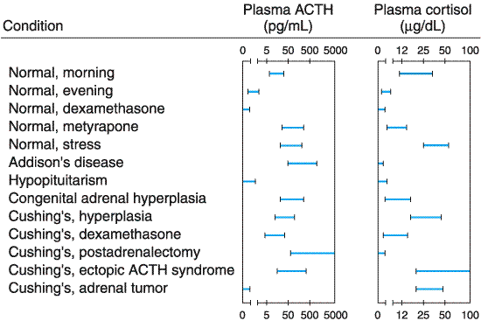
Glucocorticoids
Diagnosis of Cushings (hyPER cortisol)
24 hr Urine Free Cortisol: If high levels of cortisol in urine, then Cushings
Dexamethasone Suppression Test (below)
give 1 mg dex at 11 pm
measure plasma Cortisol.
Normal: cortisol should go down b/c of negative feedback
Cushings: cortisol should go up b/c no negative feedback
3. Plasma ACTH Assay
Mineral corticoids: Glucocorticoids (cortisol / hydrocortisone)
Normal morning = higher than evening
Normal + low dose Dexamethasone = low ACTH and cortisol b/c body senses enough glucocorticoid and stops making it
Addison's = normal ACTH but nonfunctioning adrenal corticoids
(ACTH tries to compensate)
Cushings needs high dose of Dexamethasone to inhibit cortisol
Dexamethasone has NO effect on Cushing’s ectopic ACTH syndrome
b/c dexamethasone cannot pass the BBB

Slide 12
HyPOfunction of Adrenal Gland
Hypothalamus
CRF
Secondary adrenal Insufficiency
hypothalamic-pituitary deficiency of ACTH, producing low concentrations of androgen and cortisol.
Anterior Pituitary
ACTH
Primary adrenal insufficiency
(Addison’s disease) involves the destruction of all regions of the adrenal cortex
or
Acute Adrenal Insufficiency (emergency)
Adrenal Cortex
Hypoaldosteronism
Aldosterone
Androgens
Glucocorticoids
Hold Na
Pump out K
SEX!
Sugar &
inflammation

Slide 13
Diagnosis of HyPOfunction of Adrenal Gland
Primary Insufficiency (Addison's Disease) | Secondary Insufficiency | Acute Adrenal Insufficiency
Problem with the actual adrenal gland | Problem with pituitary | Serious problem with adrenal gland
1. Hyperpigmentation 2. Decreased Aldosterone secretion 3. Severe Weight Loss, dehydration, electrolyte abnormalities 4. Abnormal response to ACTH stimulation test. When ACTH is given, the adrenal gland is suppose to respond. Since there is a problem with the adrenal gland, there is an abnormal response. | 1. No Hyperpigmentation 2. Preserved Aldosterone secretion 3. Less severe weight loss, dehydration and electrolyte abnormalities 4. Normal response to ACTH test. When ACTH is given, the adrenal gland responds normally. | Dante’s 9 Circles of DEATH!! (jk) Myalgia Malaise Anorexia Weakness Vomiting Fever HTN Shock DEATH!!! (maybe)

Slide 14
Treatment of HyPOfunction of Adrenal Gland
Primary Insufficiency (Addison's Disease) | Secondary Insufficiency | Acute Adrenal Insufficiency
Problem with the actual adrenal gland | Problem with pituitary | Serious problem with adrenal gland
1. Prednisone 5 mg qAM or Hydrocortisone 20 mg AM 2. Prednisone 2.5 mg qPM or Hydrocortisone 10 mg PM 3. If mineralocorticoid loss: Fludrocortisone acetate (mimics aldosterone) | 1. Prednisone 5 mg qAM or Hydrocortisone 20 mg AM 2. Prednisone 2.5 mg qPM or Hydrocortisone 10 mg PM 3. If mineralocorticoid loss: Fludrocortisone acetate (mimics aldosterone) | 1. Hydrocortisone 100 mg IV 2. Hydrocortisone 100 mg IV q8h for 48 hr 3. D5NS 0.5 L/h 4. If mineralocorticoid loss Fludrocortisone 0.1 mg

